Slide 1
PhishArmor
The Traffic Light for Your Inbox. Empowering everyone to navigate the digital world with confidence

Slide 2
Phishing Isn't a Server Problem. It's a Human Problem.
$3.4B
Lost to phishing attacks annually
91% of cyberattacks begin with a phishing email
Filters miss new, targeted social engineering attacks
Users are left alone to make critical security decisions
The most vulnerable among us are the most targeted
Financial and emotional consequences are devastating
The Final Click Is Always Human
Even the most advanced email filters miss sophisticated phishing attacks. They catch known threats but struggle with clever social engineering that targets people, not servers. That moment of uncertainty, hovering over a link, wondering if an email is truly legitimate, that is where the real vulnerability lies.

Slide 3

PhishArmor Empowers Your Decision
Your intelligent email co-pilot
AI-Powered Clarity in Your Inbox
You deserve clarity. PhishArmor acts as your intelligent co-pilot, using powerful AI to analyze every critical aspect of an email: sender reputation, link safety, and content cues. This complex analysis is distilled into a simple, trustworthy traffic light signal (Green, Yellow, Red) right in your inbox. You see what is safe, what is suspicious, and what is dangerous, before you click.
PhishArmor does not just give you a signal; it gives you the why. Understand the key factors behind each email's safety assessment so you can make informed decisions with confidence.

Slide 4




Simple Steps to Safer Email
Protection without disruption
Receive Email
AI Analysis
Get the Signal
Decide with Confidence
Your inbox functions as usual. No changes to your workflow or email setup.
PhishArmor instantly scans sender reputation, link safety, and content patterns using advanced AI.
A clear safety indicator (Green, Yellow, Red) appears next to the email in your inbox.
View the detailed report or trust the signal to guide your next action. Click smarter.

Slide 5






The Clarity You Need, At a Glance
Sender Verification
Safe Link Checking
Content Analysis
Verifies sender identity, analyzing domain reputation and detecting signs of impersonation so you can trust the source.
Every link is scanned against massive threat databases. See the true destination and safety status before you click.
AI reads between the lines, identifying manipulative language, suspicious requests, and common phishing patterns.
Real-Time Detection
Traffic Light Signal
Detailed Reports
Instant threat analysis as emails arrive. No delays, no waiting, just immediate protection.
Complex analysis distilled into simple Green, Yellow, Red indicators right in your inbox.
Go beyond the signal. Full breakdown of why an email was flagged, so you understand the risk.

Slide 6



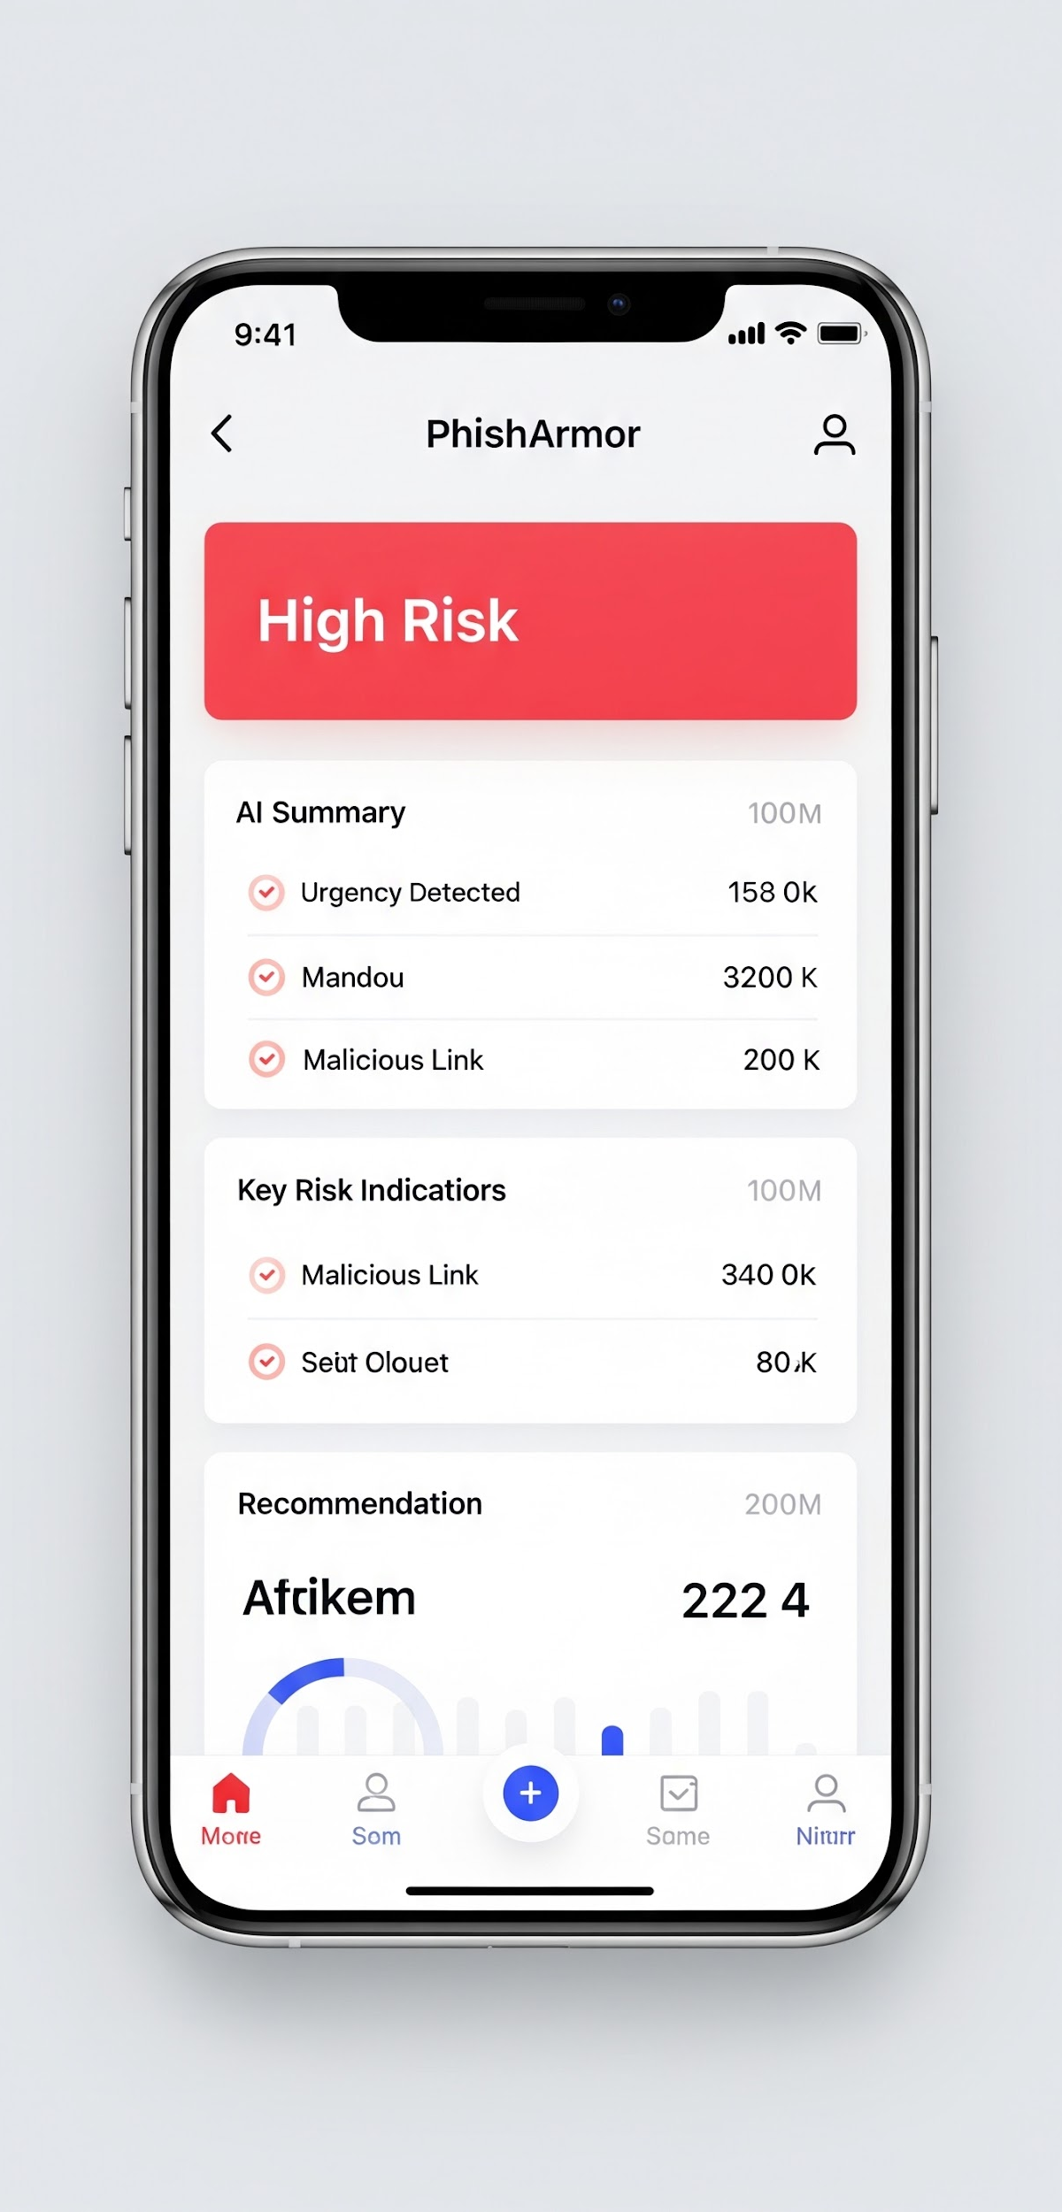
Your Email Safety Report
See exactly why an email is safe, suspicious, or dangerous
Instant Risk Assessment
Every email gets a comprehensive safety analysis. PhishArmor checks sender verification, scans all links against threat databases, detects urgency and deception in content, and matches against known phishing patterns. The result is a clear, actionable report you can trust.
The browser extension works seamlessly with Gmail and other major email providers. No complex setup, just install and start seeing your email traffic light.

Slide 7



Who We Protect
Empowering everyone to navigate email safely
Pain Points
Our Solution
Sophisticated phishing bypasses traditional filters
Users lack tools to verify suspicious emails
Non-technical users are most vulnerable
One wrong click can lead to identity theft
Existing security training is not enough
PhishArmor bridges the gap between technical security and everyday users. Our AI-powered traffic light system makes email safety intuitive for everyone, from tech-savvy professionals to seniors and students. No expertise required, just clear, trustworthy signals.

Slide 8
Market Opportunity
The global email security market is projected to reach $14.8B by 2030. With over 300 billion emails sent daily and phishing as the top attack vector, demand for user-facing protection tools is surging.
Email security is fastest-growing cybersecurity segment
Consumer and SMB segments remain massively underserved
Remote work has expanded the attack surface
Regulatory pressure driving adoption of security tools
Growing awareness creating demand for user-friendly solutions
Browser extension model enables rapid, viral distribution
$14.8B
Global Email Security Market by 2030
$3.4B
Annual Losses from Phishing Attacks
300B+
Emails Sent Daily Worldwide
91%
Cyberattacks Starting with Phishing

Slide 9

Why PhishArmor Wins
Traditional Email Filters
PhishArmor Advantage
Server-side only, miss targeted attacks
No user visibility into why emails are flagged
PhishArmor works alongside your existing email filters, adding a critical user-facing layer of protection. While filters block known threats at the server, PhishArmor empowers users to identify the sophisticated attacks that slip through.
AI-Powered Analysis
PhishArmor works alongside your existing email filters, adding a critical user-facing layer of protection. While filters block known threats at the server, PhishArmor empowers users to identify the sophisticated attacks that slip through.
No user visibility into threat details. Reactive approach leaves users guessing about email safety and unable to make informed decisions.
PhishArmor Advantage
User Empowerment
Real-time sender, link, and content verification
Clear traffic light signals and detailed reports for every email

Slide 10

Choose Your Protection Level
Start for free and upgrade when you need more
Free Plan
Premium Plan
$0
$4.99
forever
Per month
5 Emails Per Day
Manual Scanning Only
Basic AI Analysis
Real-time Threat Detection
Includes Ads
50 Emails Per Day (10x more)
Auto-scanning Capability
Sender Verification
Safe Link Checking
Ad-free Experience
Priority Support

Slide 11

Our Roadmap
Building the future of email safety
2024
2025
2026
2027
2028
Foundation
Launch
Growth
Scale
Market Leader
Product concept validated. Core AI phishing detection engine developed and tested.
Public launch of browser extension. Gmail integration live. Free and Premium tiers available.
Expand to Outlook and Yahoo Mail. Enterprise pilot program. 100K user milestone.
Mobile app launch. API for enterprise integration. Strategic partnerships with email providers.
Multi-language support. Global expansion. 1M+ users. Category-defining brand in email safety.

Slide 12
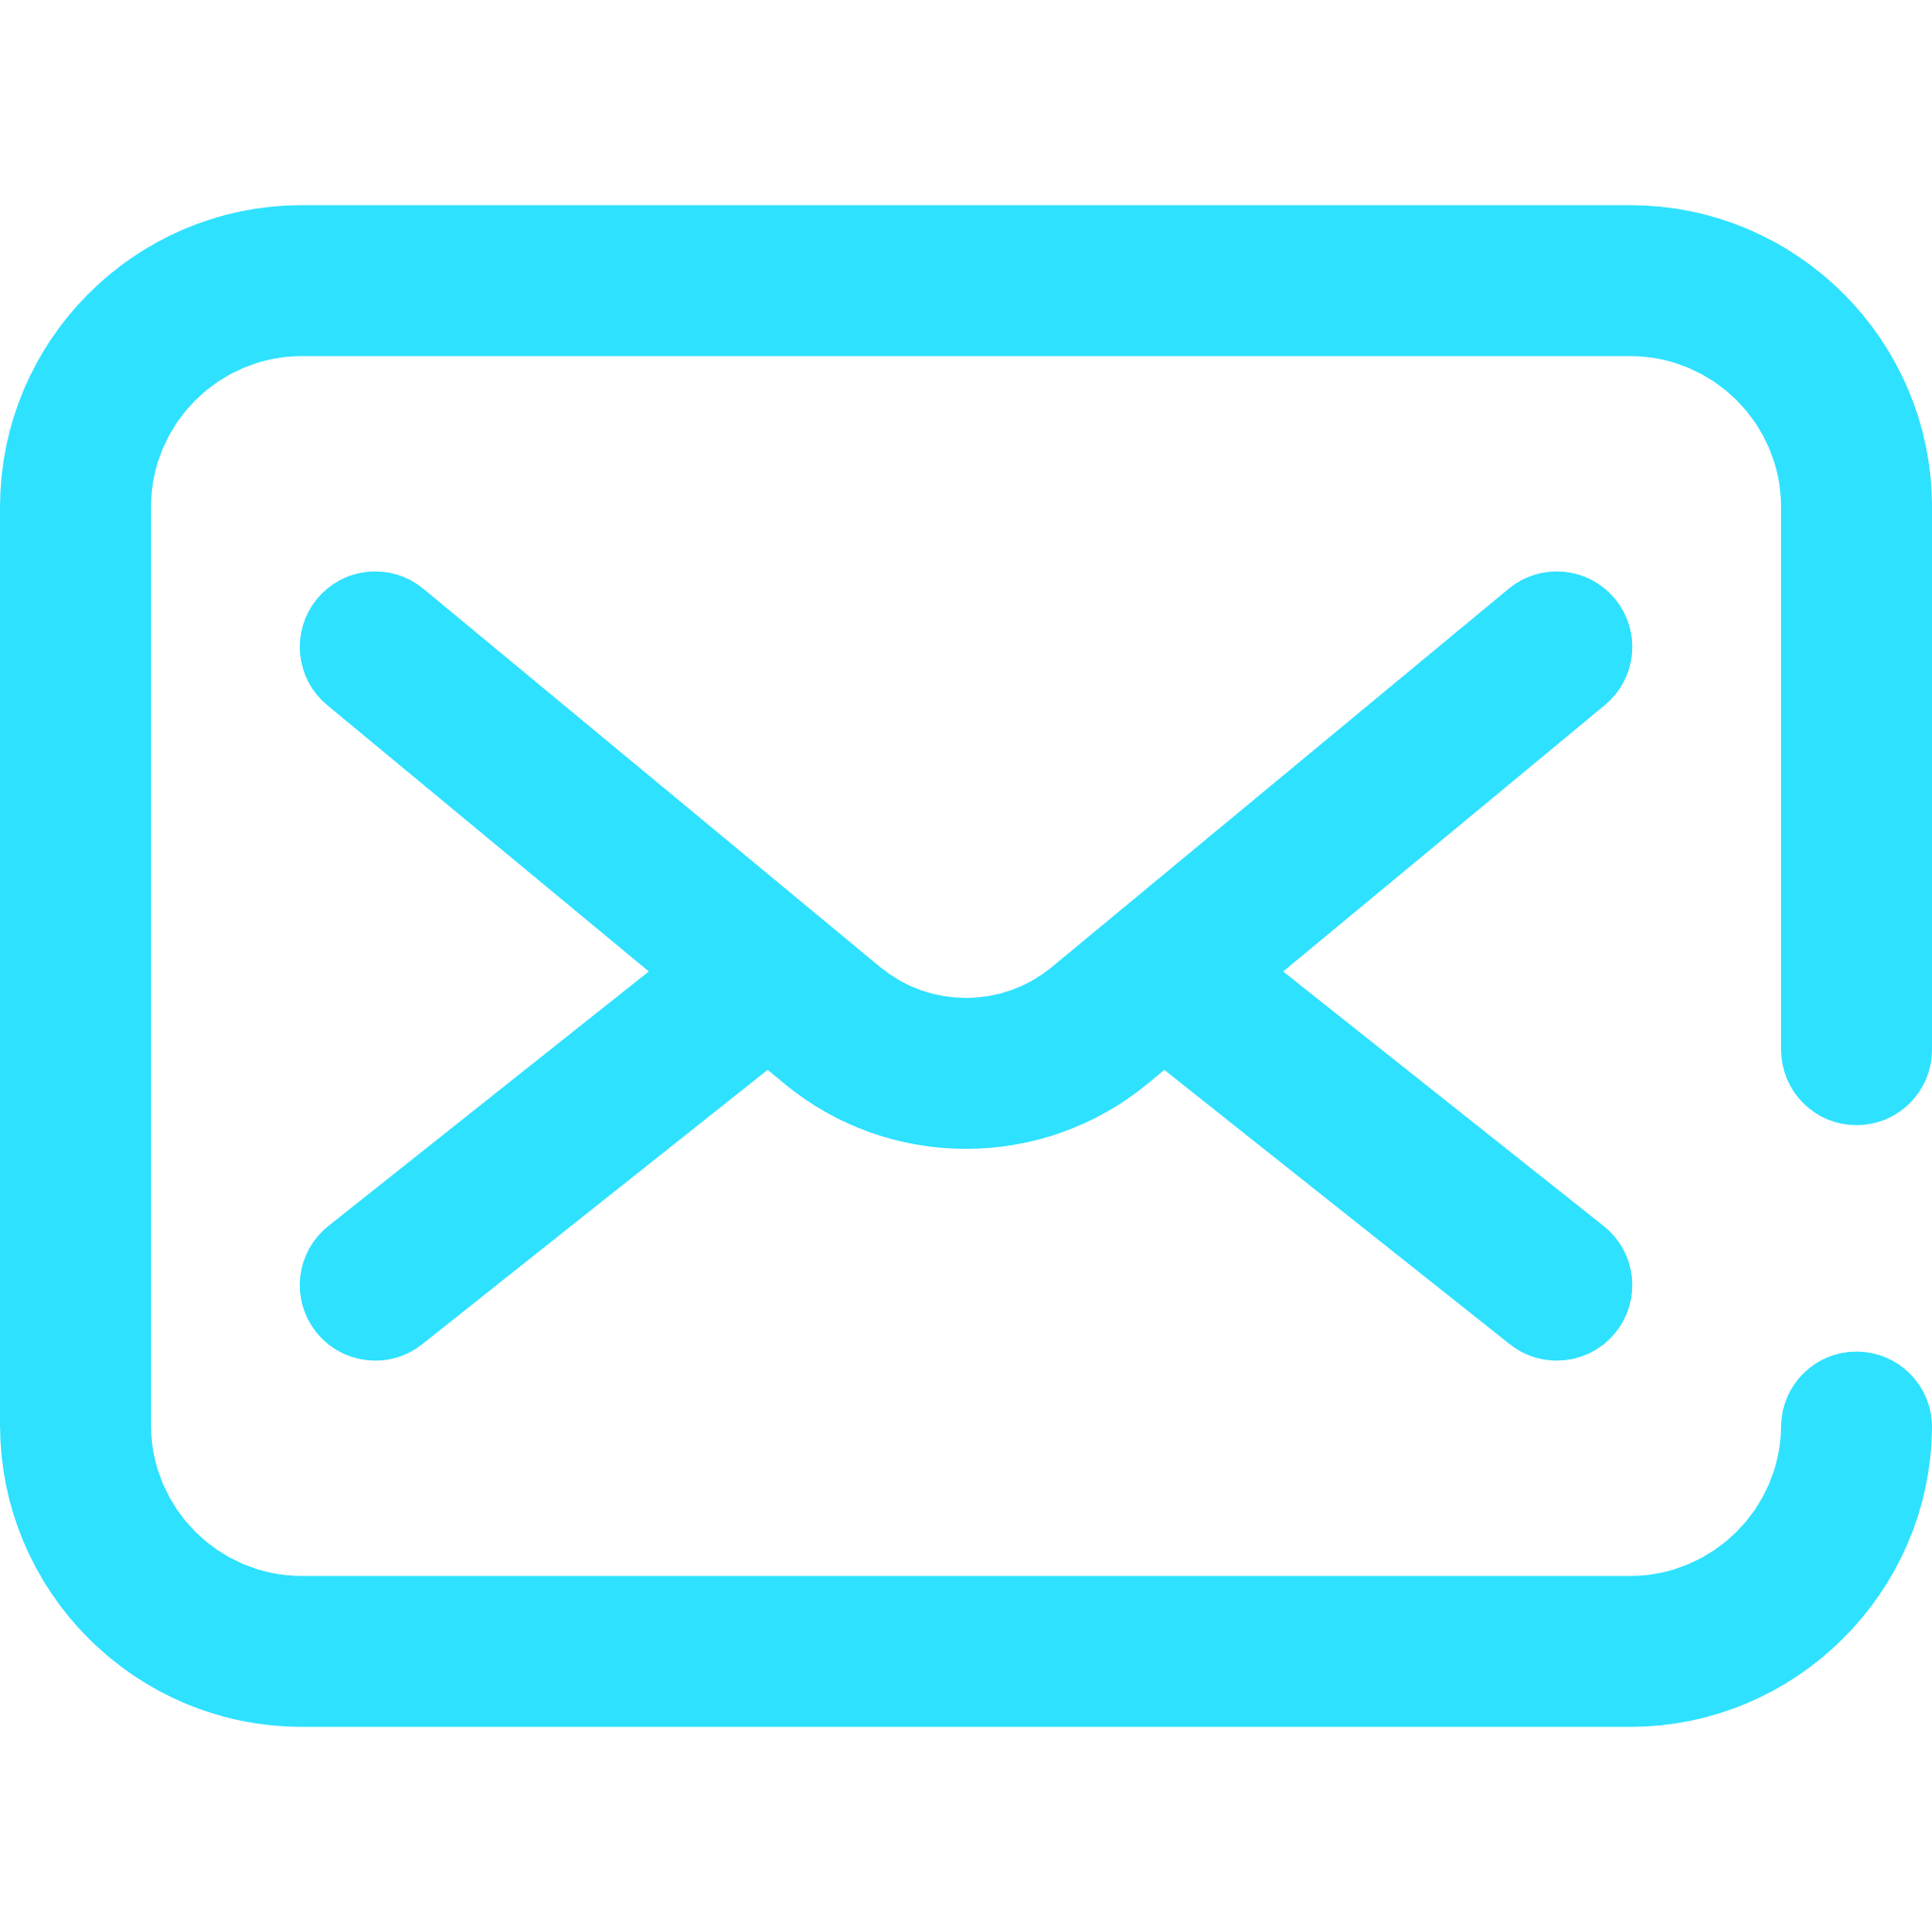


Thank You
hello@phisharmor.ai
+12 345 678 91
www.phisharmor.ai

